Slide 1
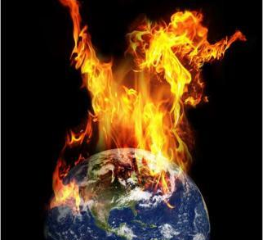
Global Warming
Presented By:
Zareen
Vasudha
Neeta
Jayshree

Slide 2
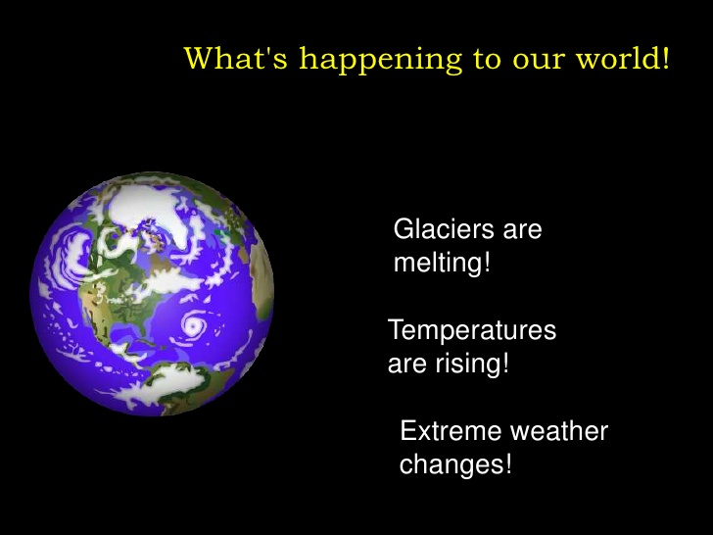

Slide 3
What is Climate Change?
The Earth is in a constant state of climate change.
Earth has experienced many cycles of global warming and cooling.
The warm and cold periods can last from thousands to millions of years.
Right now, many scientists who study environmental sciences believe the climate is warming.
The Earth's temperature has increased by one degree Fahrenheit in the last hundred years. This may seem like a very tiny change, but even a tiny change in the climate has huge consequences.

Slide 4
Global surface temperature has increased by around 1.8°F (1.0°C) since the late 1800s.
More than half of this increase has occurred since the 1970s, and every decade since then has been warmer than the one before it.
Major changes in global climate have occurred throughout our planet's history – long before humans could possibly have been a factor.
Researchers overwhelmingly agree that the main cause of recent global warming is the addition of greenhouse gases to the atmosphere (primarily carbon dioxide) through the burning of fossil fuels.
Greenhouse gases warm the climate by allowing sunlight to reach Earth but absorbing radiation from Earth before it escapes to space.
The amount of carbon dioxide in the atmosphere has increased every year for more than 60 years; it is now about 30% greater than it was in the 1950s.

Slide 5
DATASET
Kaggle : https://www.kaggle.com/berkeleyearth/climate-change-earth-surface-temperature-data
EPA (United States Environmental Protection Agency) : https://www.epa.gov/ghgemissions
Studied Global Land Temperature (COUNTRY) - 1900 – 2013
Studied Green House Gas Emission - 1990 – 2010
- Industry
- Residential & commercial
- Transport
- Agriculture
- Forestry
- Land use sources
- Energy
- Waste

Slide 6
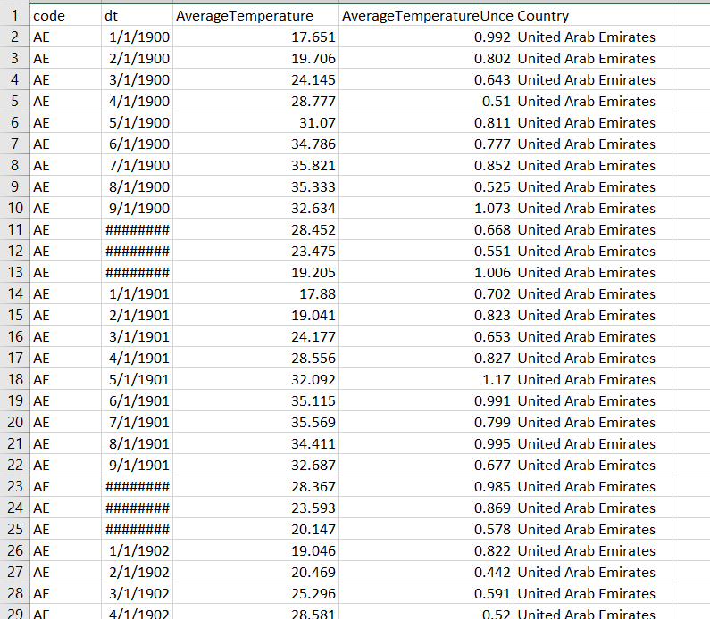
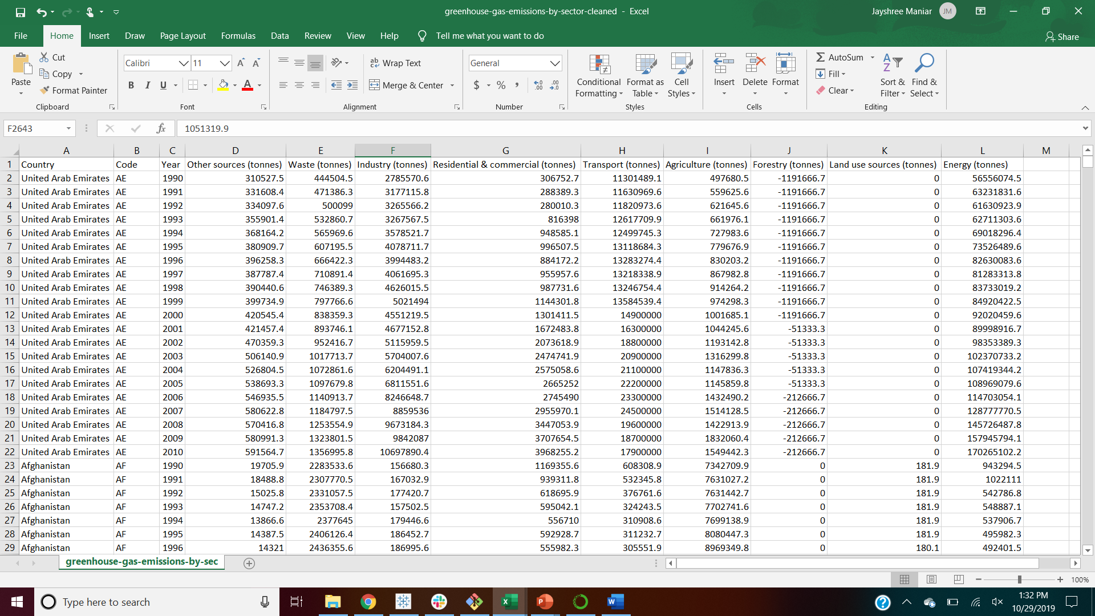
Sample DATA

Slide 7
QUESTIONS :
Top 5 countries affecting the Global warming
Green house gases emitted by Country
Which country created most waste ?
Which sector contributed the most ?
Rising temperature by country in last 20 years
Last century overall temperature changes
Map of rising temperature

Slide 8
CLOUD ETL
Loaded data on AWS S3 BUCKET
Created a PostgreSQL Database in AWS RDS
Connected to PostgreSQL RDS using ZEPL through JDBC interpreter
Retrieved the data from RDS.

Slide 9
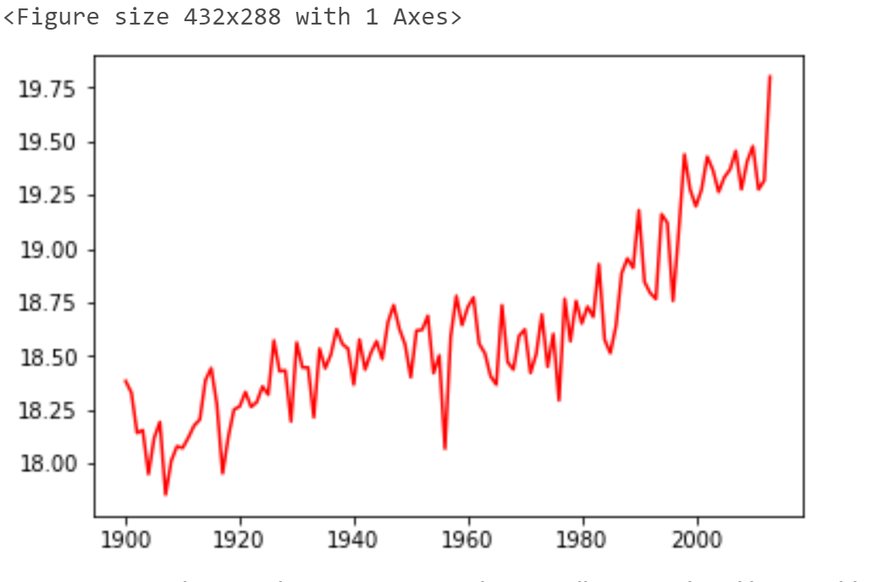
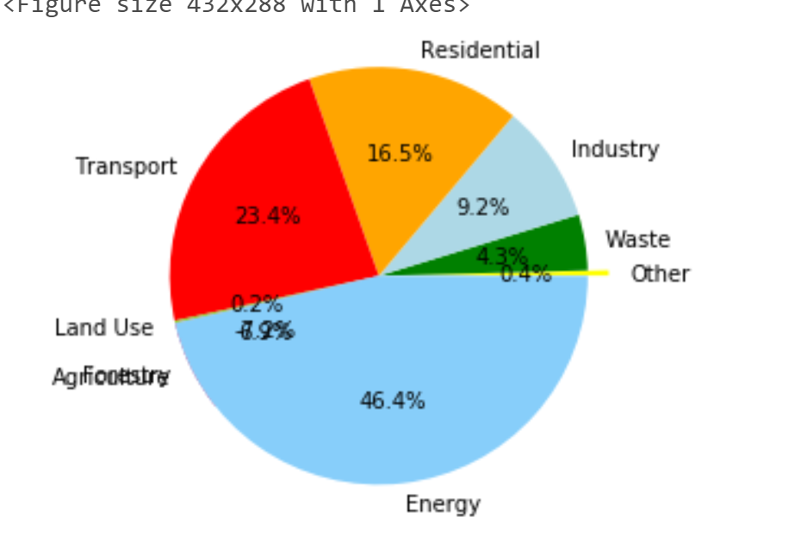
VISUALIZATION USING PYSPARK

Slide 10
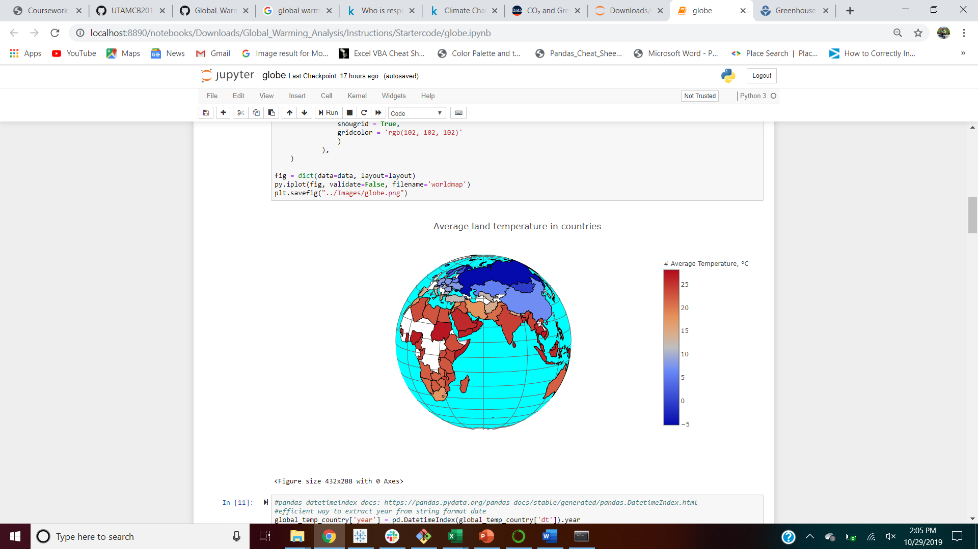

Visualization using matplotlib

Slide 11
VISUALIZATION USING TABLEAU

Slide 12
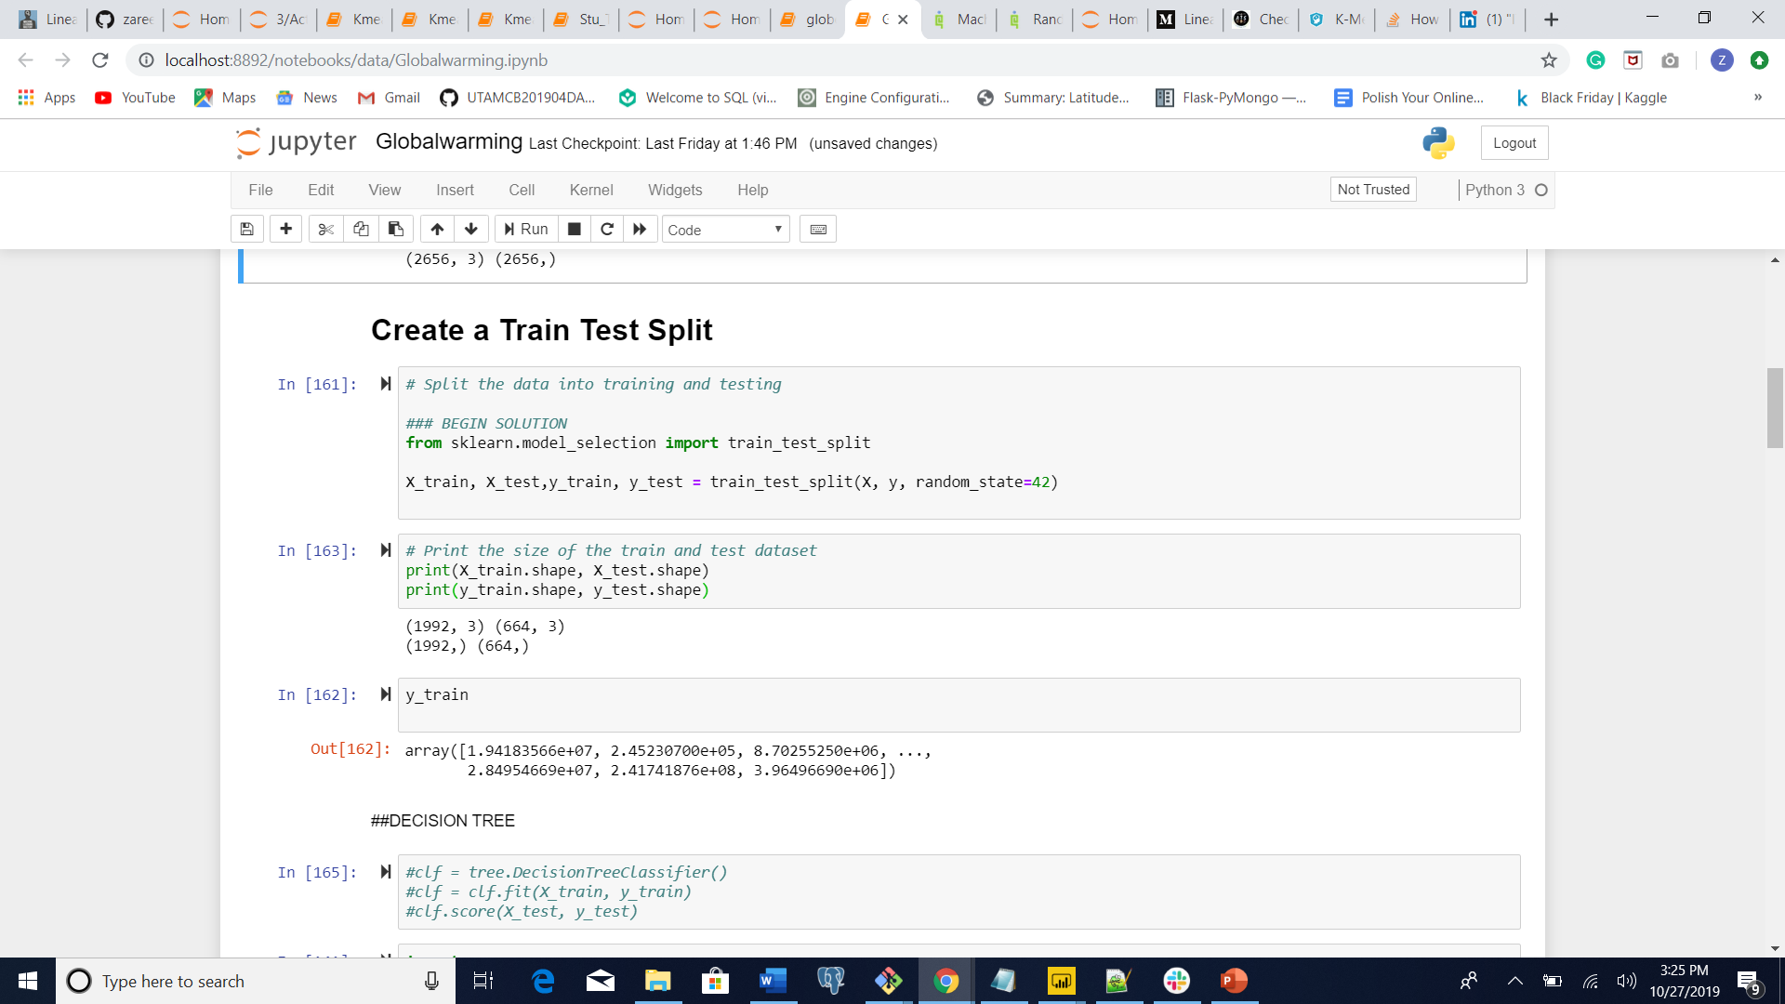
MACHINE LEARNING
STEPS
Select features (columns)
Create a Train Test Split

Slide 13
RANDOM FOREST
It is one of the most accurate learning algorithms available. For many data sets, it produces a highly accurate classifier.
It runs efficiently on large databases.
We got accuracy of 0.99

Slide 14
ANALYSIS AND PREDICTIONS
Major countries affecting the Global warming are
- China
- United States
- India
Major sectors affecting the Global warming are
- Energy
- Industry
- Forestry
- Agriculture
Regulations must be placed immediately on these sectors to control or stop the Global warming
Climate change has brought about possibly permanent alterations to Earth's geological, biological and ecological systems.

Slide 15
Consequences of Global warming :
Higher death rates
Higher death rates
Higher death rates
More frequent and severe weather
Higher death rates
Dirtier air
Higher wildlife extinction rates
More acidic oceans
Higher sea levels

Slide 16
Ways to Stop Global Warming
- Change a light. Replacing one regular light bulb with a compact fluorescent light bulb will save 150 pounds of carbon dioxide a year. - Drive less. Walk, bike, carpool or take mass transit more often. - Recycle more. - Check your tires. - Use less hot water. - Avoid products with a lot of packaging. - Adjust your thermostat. - Plant a tree.

